Slide 1





Exploring Workforce Trends with the Longitudinal Employer-Household Dynamics Data Tools
September 22, 2022
Presented by: Earlene Dowell
US Census Bureau

Slide 2

census.gov
To obtain an archived copy, visit census.gov / Explore Data / Census Academy / Webinars / Webinar Series
Find stories and free visualizations under ‘Library’
Outline
About the Census Bureau
Longitudinal Employer-Household Dynamics Program (LEHD)
LEHD Data Products

Slide 3
About the Census Bureau
Decennial Population
and Housing Census
Every 10 years
Economic Census
Every 5 years
Census of Governments
Every 5 years
American Community Survey
Annual
Annual Retail Trade
Annual
Plus more than 130
demographic and economic surveys every year
The U.S. Census Bureau is the federal government’s largest statistical agency.
We conduct more than 130 censuses and surveys each year, including
  The Decennial Census – the once-a-decade population and housing count of the United States
  The American Community Survey – the ongoing annual survey of the nation’s population
  The Economic Census – the official five-year measure of American business
  The Census of Governments – the official five-year measure of the nation's state and local government sector
Our mission is to serve as the leading source of quality data about America’s people, places, and economy.

Slide 4
Monthly
and Quarterly
Surveys
Annual Surveys
Economic Census – Every 5 years
Census Economic Surveys
Census Bureau Economic Surveys are a key source for official statistics companies can use:
  Monthly and Quarterly are small sample surveys that provide the most TIMELY data available
  Annual surveys have larger samples and provide the most up-to-date TREND data available
  Every 5 years, the Economic Census measures all businesses and provides the most COMPREHENSIVE data available
These surveys set the standard for U.S. economic statistics, and are fueled by the data provided by individual businesses

Slide 5
Longitudinal Employer-Household Dynamics Program

Slide 6
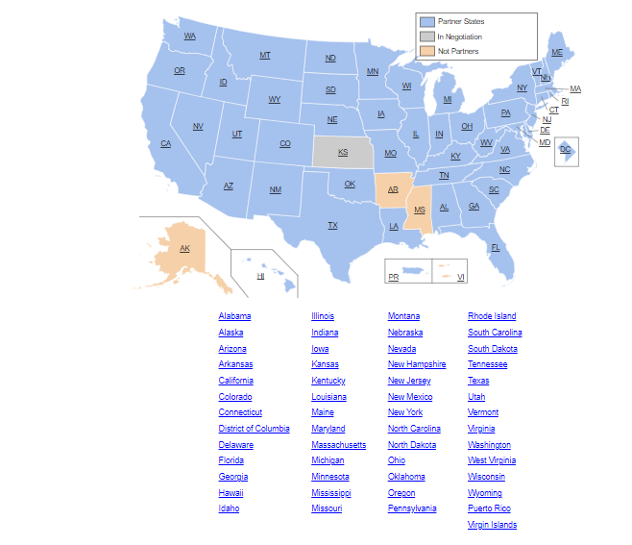
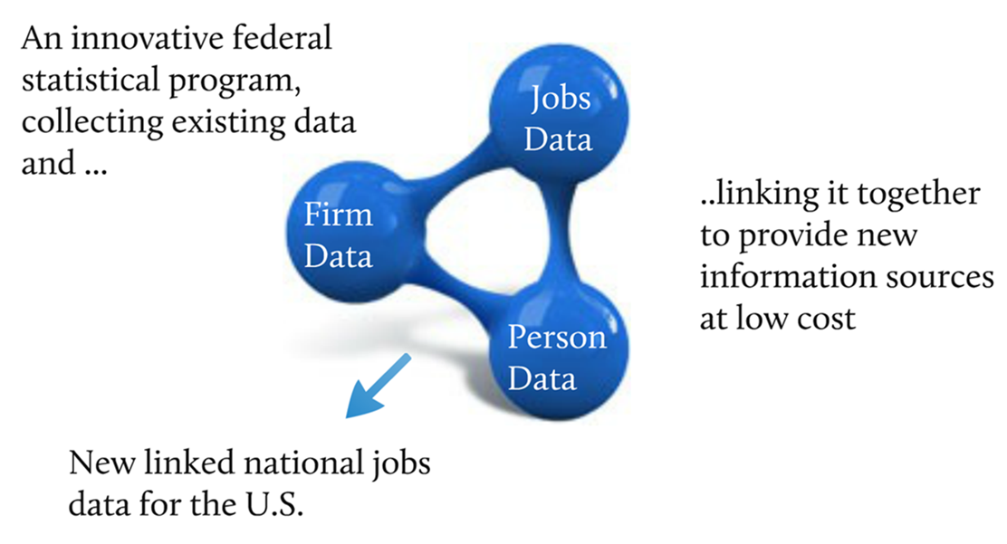
About LEHD
LEHD Program

Slide 7
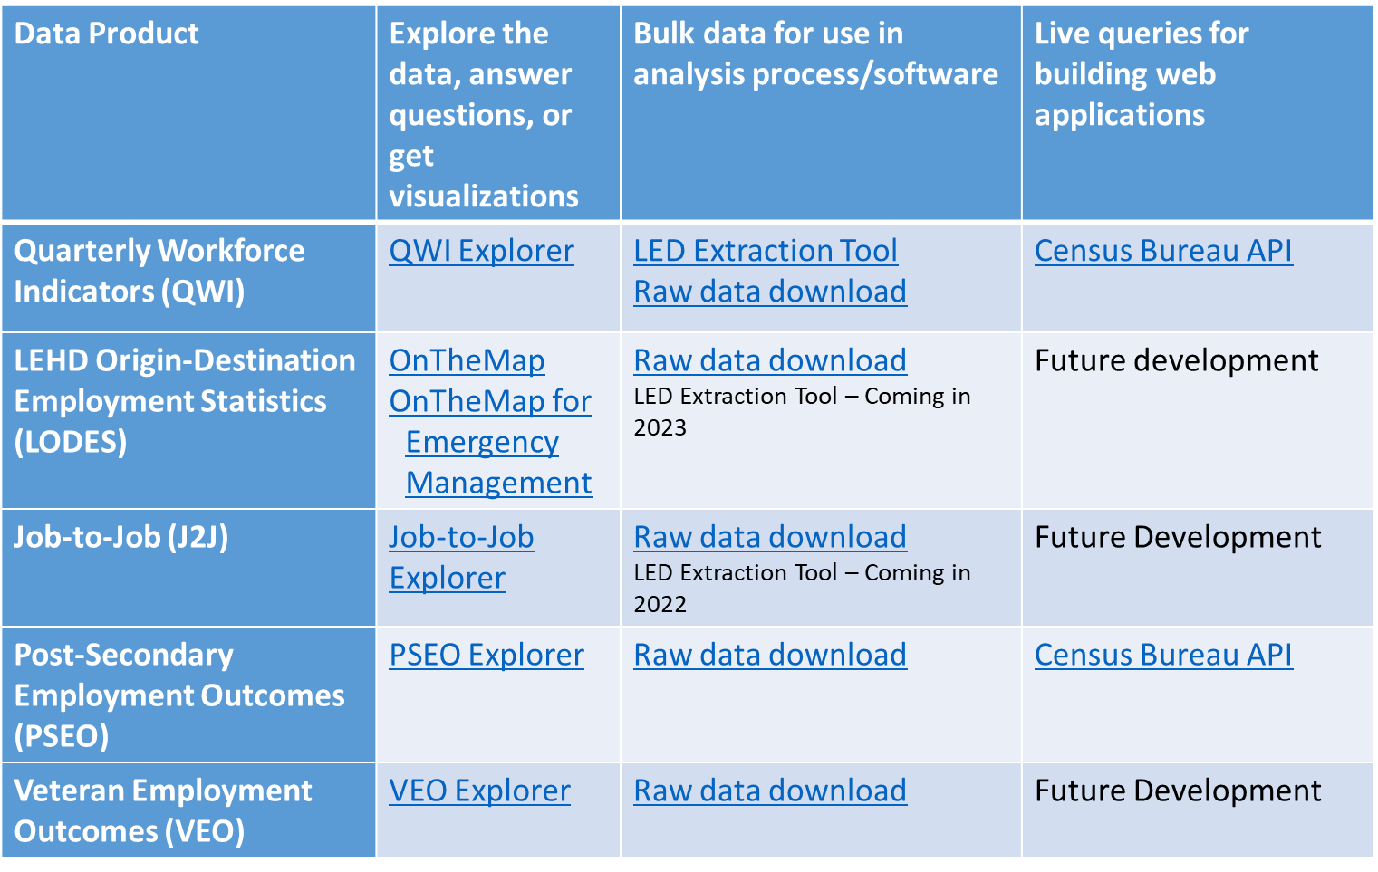
LEHD Program

Slide 8
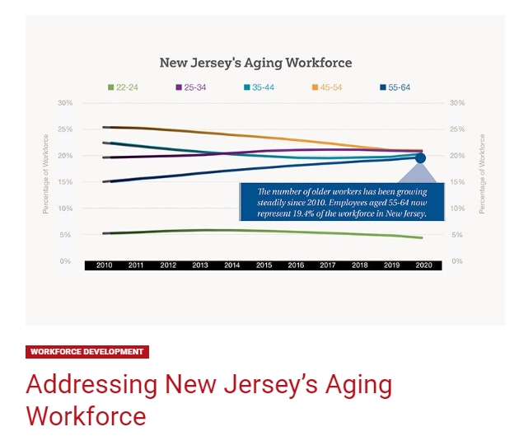
LEHD Program
Addressing New Jersey’s Aging Workforce - New Jersey Business Magazine (njbmagazine.com)

Slide 9
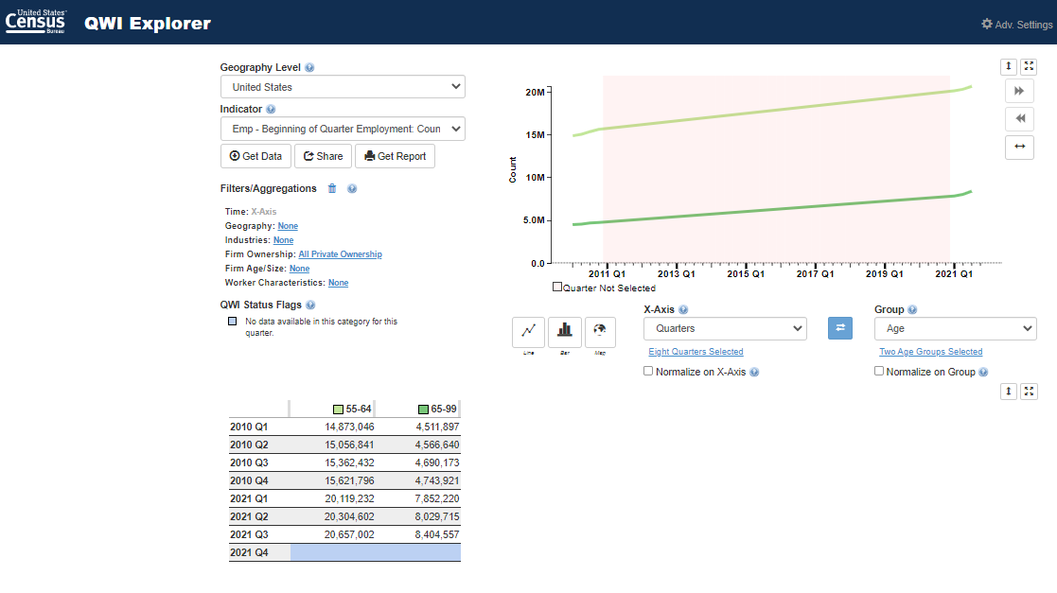
LEHD Program
https://qwiexplorer.ces.census.gov/exp-r/12a133.html?st=US&v=line&fc=true&t=ac0&extra=x%3D0%26g%3D0

Slide 10
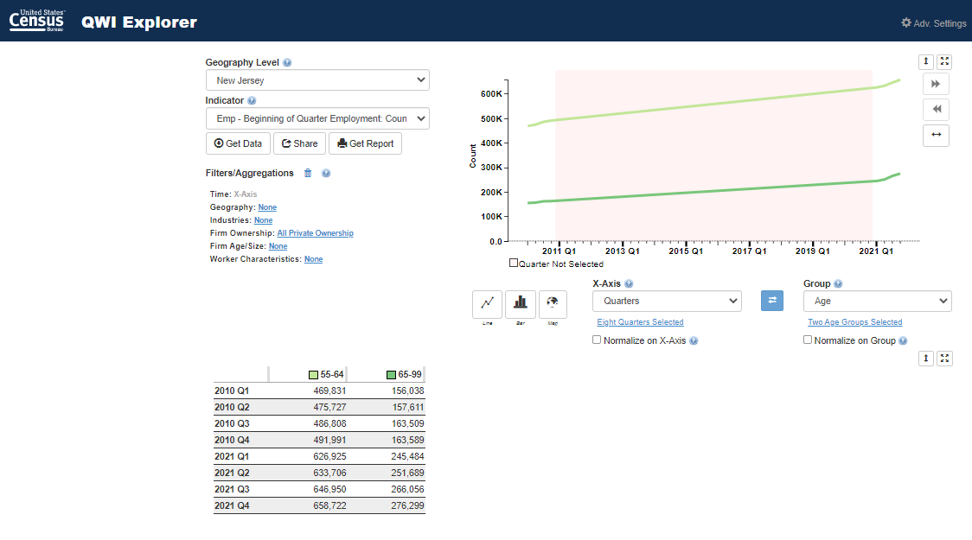
Aging Workforce in New Jersey
LEHD Program
https://qwiexplorer.ces.census.gov/exp-r/12a135.html?st=NJ&v=line&fc=true&t=ac0&extra=x%3D0%26g%3D0

Slide 11
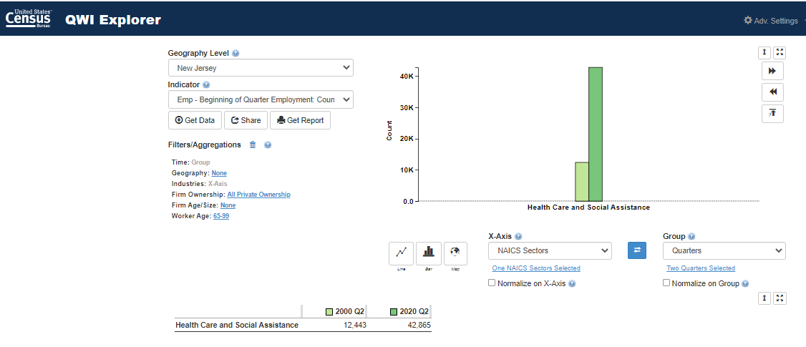
Growth of 65 and Older in Health Care from 2000 and 2020
LEHD Program

Slide 12

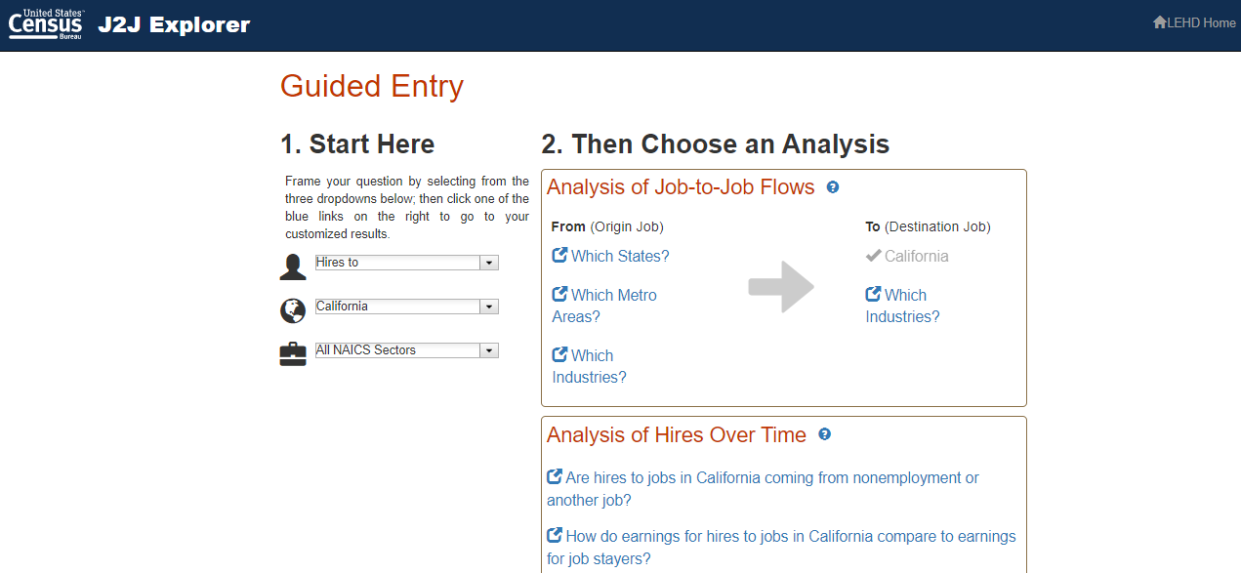
Job-to-Job Flows Explorer

Slide 13
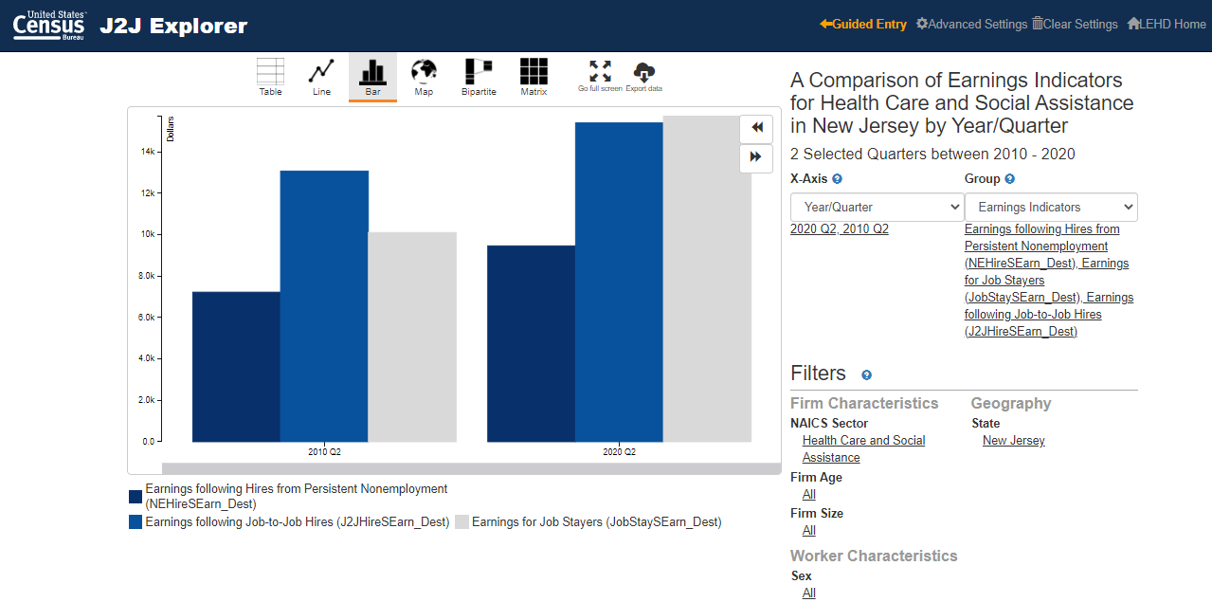

Slide 14
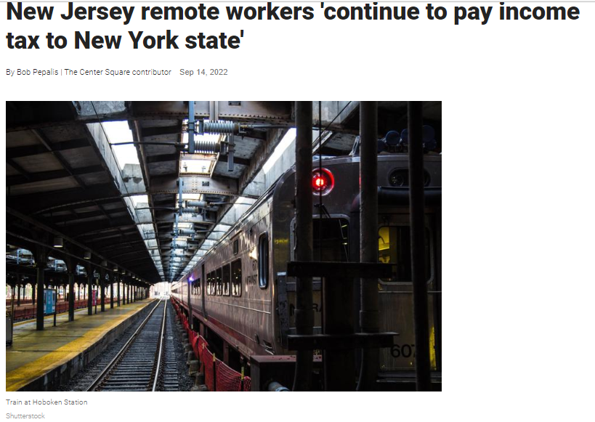
https://www.thecentersquare.com/new_jersey/new-jersey-remote-workers-continue-to-pay-income-tax-to-new-york-state/article_937a59d8-341a-11ed-b1f6-e7ed7dfc02e0.html

Slide 15
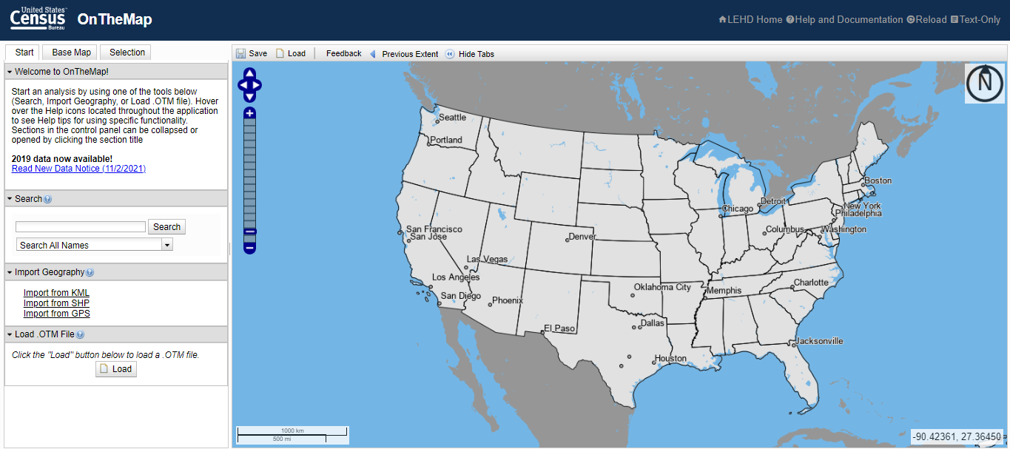

Slide 16
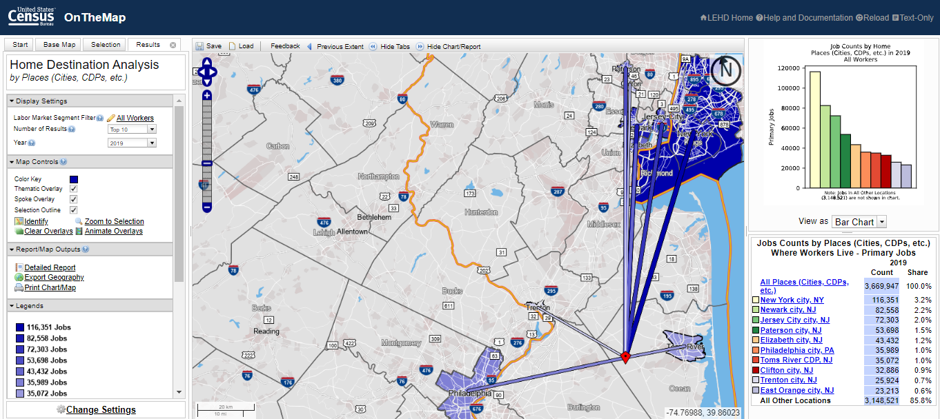
OnTheMap Destination

Slide 17
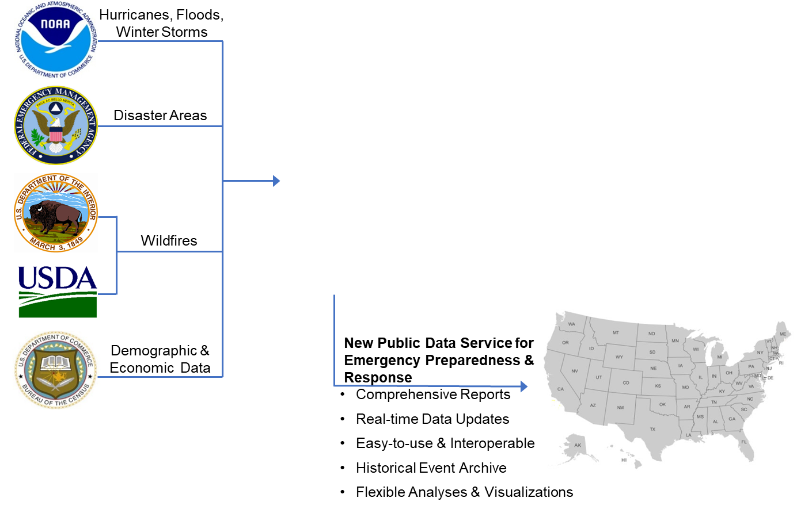
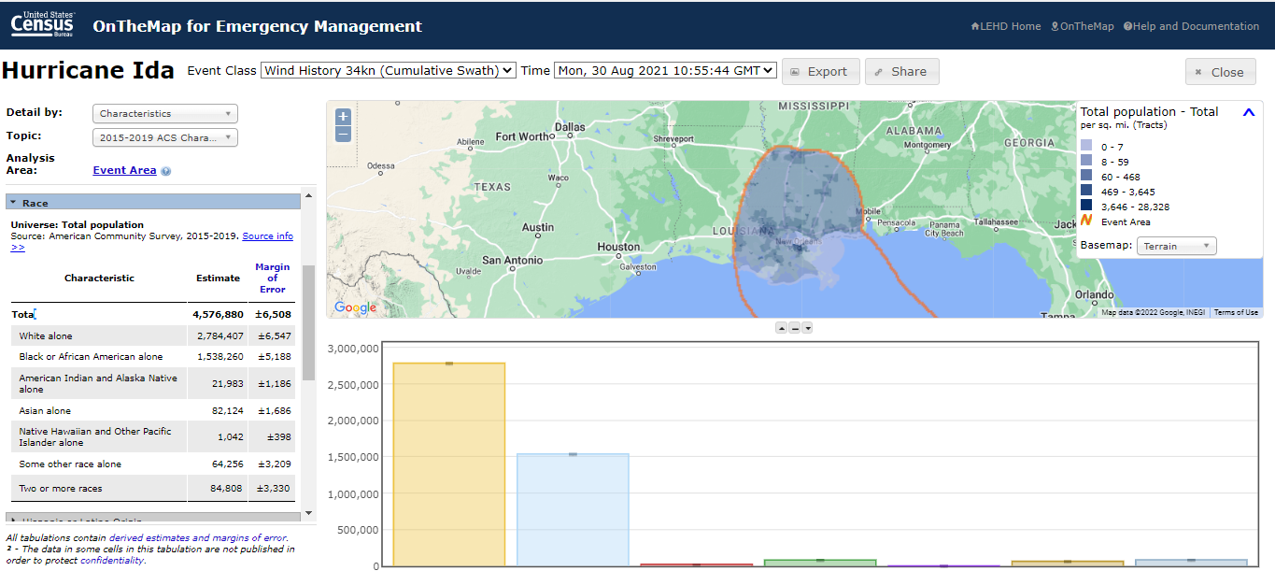
LEHD Program

Slide 18
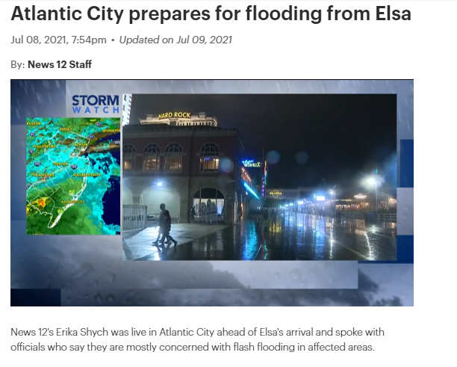
Hurricane Elsa

Slide 19
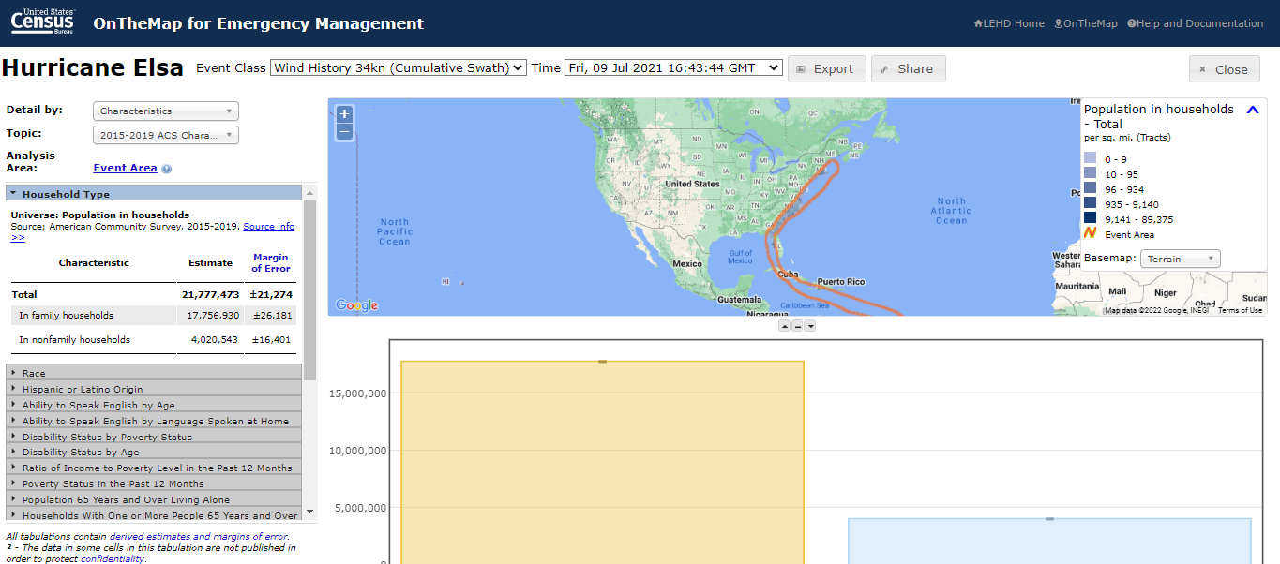

Slide 20
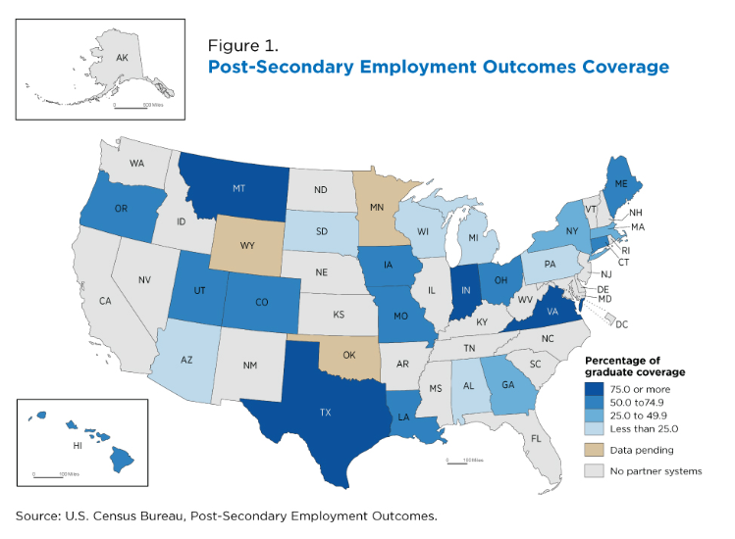

Slide 21
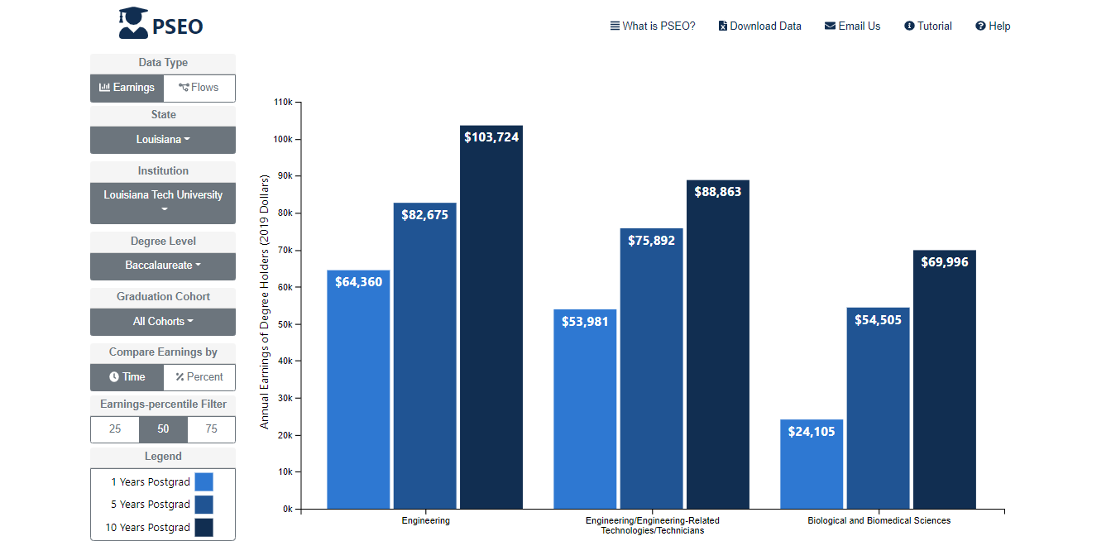

Slide 22
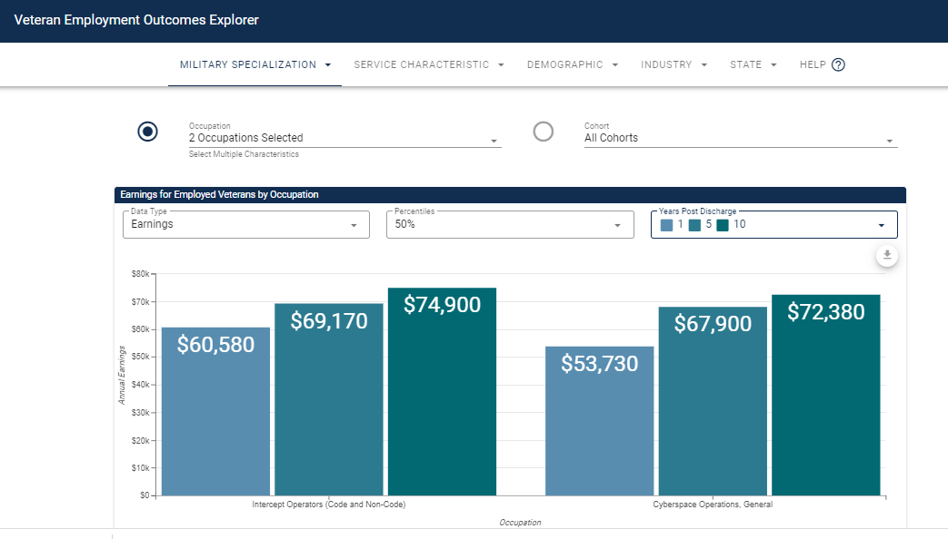

Slide 23
LEHD Program
Summary and Resources
Help and Documentation
  Quarterly Workforce Indicator
  https://lehd.ces.census.gov/applications/help/qwi_explorer.html#!what_is_qwi_explorer
  Job-to-Job Flows
  https://lehd.ces.census.gov/applications/help/j2j_explorer.html#!what_is_j2j_explorer
  OnTheMap
  https://lehd.ces.census.gov/applications/help/onthemap.html#!getting_started
  OnTheMap for Emergency Management
  https://lehd.ces.census.gov/applications/help/onthemap_em.html#!getting_started
  Post Secondary Employment Outcomes
  https://lehd.ces.census.gov/data/pseo_experimental.html#methodology
  Veteran Employment Outcomes
  https://lehd.ces.census.gov/data/veo_experimental.html

Slide 24



Q & A and Thank You!
Contact Information:
Earlene K.P. Dowell
301-763-9628
earlene.kp.dowell@census.gov
To schedule additional training with a Census Data Dissemination Specialist in your area, please call 844-Ask-Data
Or email us at: census.askdata@census.gov

